Slide 1
THE UNIVERSITY OF ZAMBIA
School of Natural Sciences
Department of Computing and Informatics
4th Year Project Presentation
16 October 2026
Notes:
We present our final-year project checkpoint dated 16 October 2026.

Slide 2
COMPUTER SCIENCE
4TH YEAR PROJECT PRESENTATION
Student Information System
Design and Implementation
with Moodle Integration
Chitundu Milimbo and Charles Hangoma
Supervisor: Professor Jackson Phiri
16 October 2026
Notes:
We are Chitundu Milimbo and Charles Hangoma. Our supervisor is Professor Jackson Phiri. The proposal used Django and MySQL. We adopted the repository locked stack: Next.js, NestJS, TypeScript and PostgreSQL.

Slide 3
PRESENTATION OUTLINE
Introduction and background
Problem statement
Aim and objectives
Research questions
Literature review
Methodology and system design
Results and discussion
Conclusion and recommendations
References
Notes:
We explain the design and implementation described on this slide. Our evidence is the project handbook and implementation checkpoint dated 16 October 2026.

Slide 4
INTRODUCTION
We developed a Student Information System (SIS) for university administration and student services.
Moodle supports teaching and learning. Our SIS owns registration and official academic records.
Our project connects these responsibilities through controlled integration workflows.
Notes:
We explain the design and implementation described on this slide. Our evidence is the project handbook and implementation checkpoint dated 16 October 2026.

Slide 5
BACKGROUND OF THE STUDY
Students depend on consistent records across admissions, registration and their learning platform.
Moodle web services support external access to users, courses and enrolments.
We use a configurable university structure and demonstration policies to exercise these workflows.
Notes:
We explain the design and implementation described on this slide. Our evidence is the project handbook and implementation checkpoint dated 16 October 2026.

Slide 6
STATEMENT OF THE PROBLEM
Disconnected administrative and learning records create duplicate work and inconsistent course access.
A successful registration must remain valid when Moodle is unavailable.
Staff need traceable approval, reconciliation and recovery rather than manual edits without history.
Students need clear registration status, personal timetables and useful support routes.
Notes:
We explain the design and implementation described on this slide. Our evidence is the project handbook and implementation checkpoint dated 16 October 2026.

Slide 7
AIM OF THE STUDY
To design and implement a unified Student Information System with bidirectional Moodle integration and a governed AI layer for administrative workflows and proactive student support.
Notes:
We explain the design and implementation described on this slide. Our evidence is the project handbook and implementation checkpoint dated 16 October 2026.

Slide 8
RESEARCH OBJECTIVES
Develop modular SIS administration and integrate Moodle using web services and LTI 1.3.
Implement governed AI for student enquiries, staff summaries, risk insights and opt-in wellbeing support.
Notes:
We explain the design and implementation described on this slide. Our evidence is the project handbook and implementation checkpoint dated 16 October 2026.

Slide 9
RESEARCH QUESTIONS
How can we preserve authoritative SIS records while linking course access in Moodle?
How can configurable policies support university workflows and independent approvals?
What controls must precede AI assistance using student information?
Notes:
We explain the design and implementation described on this slide. Our evidence is the project handbook and implementation checkpoint dated 16 October 2026.

Slide 10
LITERATURE REVIEW (1/3)
Moodle web services provide external functions for user, course and enrolment operations [1].
We use this provisioning lane to demonstrate course access on MoodleCloud.
Our design separates successful SIS registration from later integration delivery.
Notes:
Primary source [1]: https://docs.moodle.org/503/en/Using_web_services and https://moodledev.io/docs/5.0/apis/subsystems/external. Accessed 16 October 2026.

Slide 11
LITERATURE REVIEW (2/3)
LTI 1.3 defines secure launches between a learning platform and an external tool [2].
This supports a separate tool launch lane alongside web service provisioning.
LTI launch and single sign-on remain future implementation work in our current build.
Notes:
Primary source [2]: https://www.imsglobal.org/spec/lti/v1p3/. LTI 1.3 Final Release, 2019. Our present demonstrator does not claim a working LTI launch.

Slide 12
LITERATURE REVIEW (3/3)
NIST AI RMF 1.0 structures AI risk management around Govern, Map, Measure and Manage [3].
Our proposed assistant requires permission checks, approved knowledge and human escalation.
We have not completed or evaluated a deployed student AI assistant.
Notes:
Primary source [3]: NIST AI 100-1 (2023), https://doi.org/10.6028/NIST.AI.100-1 and https://www.nist.gov/itl/ai-risk-management-framework. Our AI assistant is a planned capability, not a tested deployed service.

Slide 13
RESEARCH METHODOLOGY (1/4)
Iterative system development
  We map handbook requirements to task packets and vertical slices.
  We implement UI, API, database state and audit behaviour together.
  We test isolated policies and representative student workflows.
  We record unresolved capabilities separately from demonstrated behaviour.
Notes:
We explain the design and implementation described on this slide. Our evidence is the project handbook and implementation checkpoint dated 16 October 2026.

Slide 14
RESEARCH METHODOLOGY (2/4)
Next.js web interface
NestJS modular API
PostgreSQL
MoodleCloud
Dashed path: live delivery pending
Notes:
Architecture view from our implementation-reviewed diagram sources. Next.js serves the web interface. A NestJS modular monolith handles business operations. PostgreSQL stores authoritative records and outbox evidence. Moodle simulator delivery and separate MoodleCloud provisioning are different execution paths. Automatic live delivery remains incomplete.

Slide 15
RESEARCH METHODOLOGY (3/4)
PostgreSQL stores academic records, versioned decisions and integration evidence.
Scoped roles control access to each workspace and student record.
Independent reviewers approve sensitive publication decisions.
Audit records and immutable snapshots preserve the history of consequential changes.
Notes:
We explain the design and implementation described on this slide. Our evidence is the project handbook and implementation checkpoint dated 16 October 2026.

Slide 16
RESEARCH METHODOLOGY (4/4)
We use API tests, connected database checks and browser journeys.
Current local checks passed four sign-in journeys and six workspace database checks.
A prior release passed 137 main browser tests and 26 Moodle deferral tests.
These checks do not replace institutional user acceptance testing.
Notes:
Evidence sources: current checkpoint auth browser log: .local-release/auth-browser-20261016.log, four passed browser checks. Six connected workspace database checks passed in isolation. Prior release CI 38690707307 passed 137 main browser and 26 Moodle deferral tests. These results belong to different runs and are not a combined test total. The whole final checkpoint suite has not passed as one release run.

Slide 17
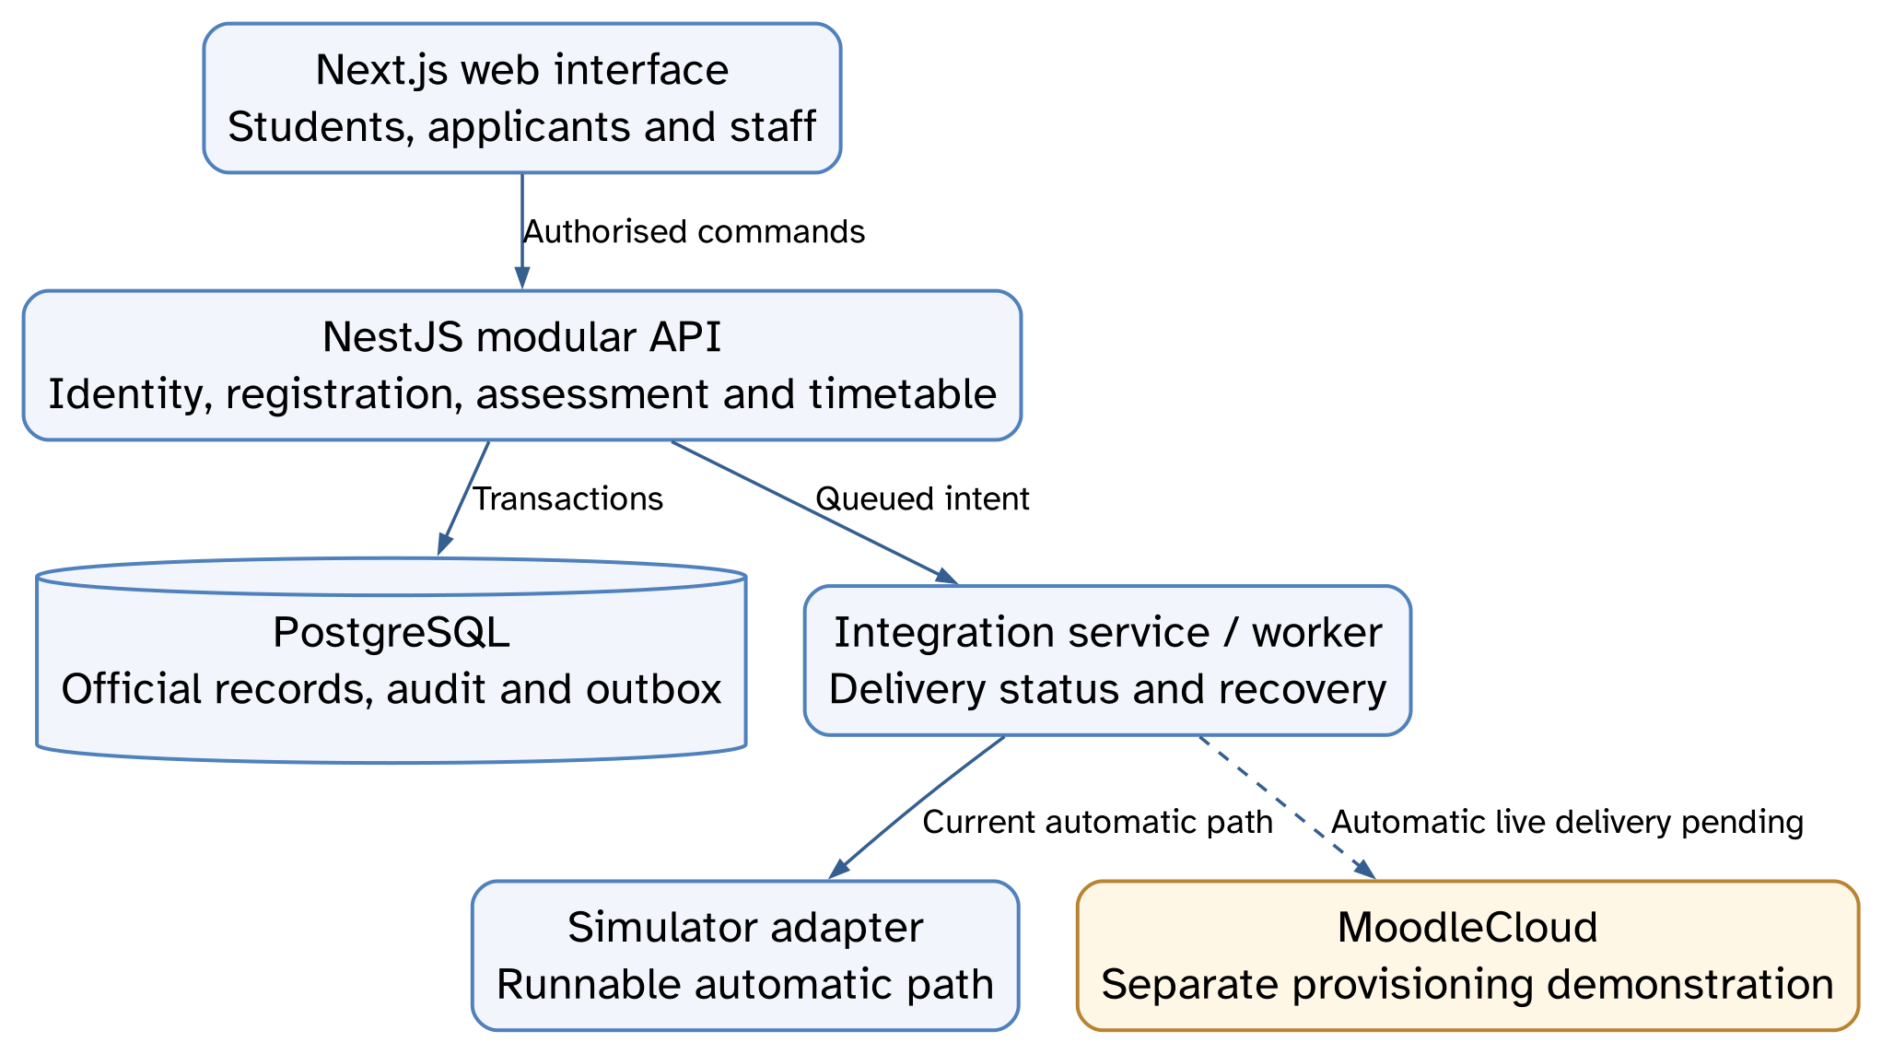
SYSTEM ARCHITECTURE
SIS decisions commit before external delivery.
Notes:
SIS decisions commit before external delivery.
Presentation view: Full screenshot.
Capture source: Selected presentation view derived from the source-audited project diagrams included in the report and diagram atlas. We show the modular API, shared database, worker, simulator and separate cloud demonstration. Dashed live path is not a claim of completed automatic live delivery.
Evidence type: Software engineering design of the implemented checkpoint; selected scope, with unfinished live integration labelled.
The captured state shows the workflow at the time of capture. It does not establish completion of every later transition.

Slide 18
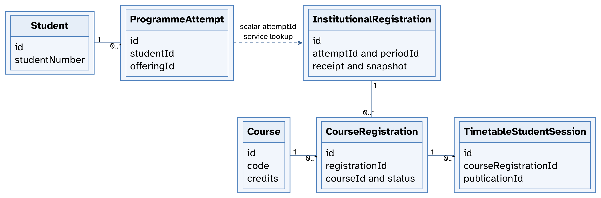
DOMAIN CLASS MODEL
Solid: schema relation. Dashed: scalar-key lookup.
Notes:
Solid: schema relation. Dashed: scalar-key lookup.
Presentation view: Full screenshot.
Capture source: Selected presentation view derived from the source-audited project diagrams included in the report and diagram atlas. Selected domain entities and multiplicities. ProgrammeAttempt to InstitutionalRegistration is a scalar-key service lookup, not a declared Prisma foreign key. Other fields and relations are omitted for presentation clarity.
Evidence type: Software engineering design of the implemented checkpoint; selected scope, with unfinished live integration labelled.
The captured state shows the workflow at the time of capture. It does not establish completion of every later transition.

Slide 19
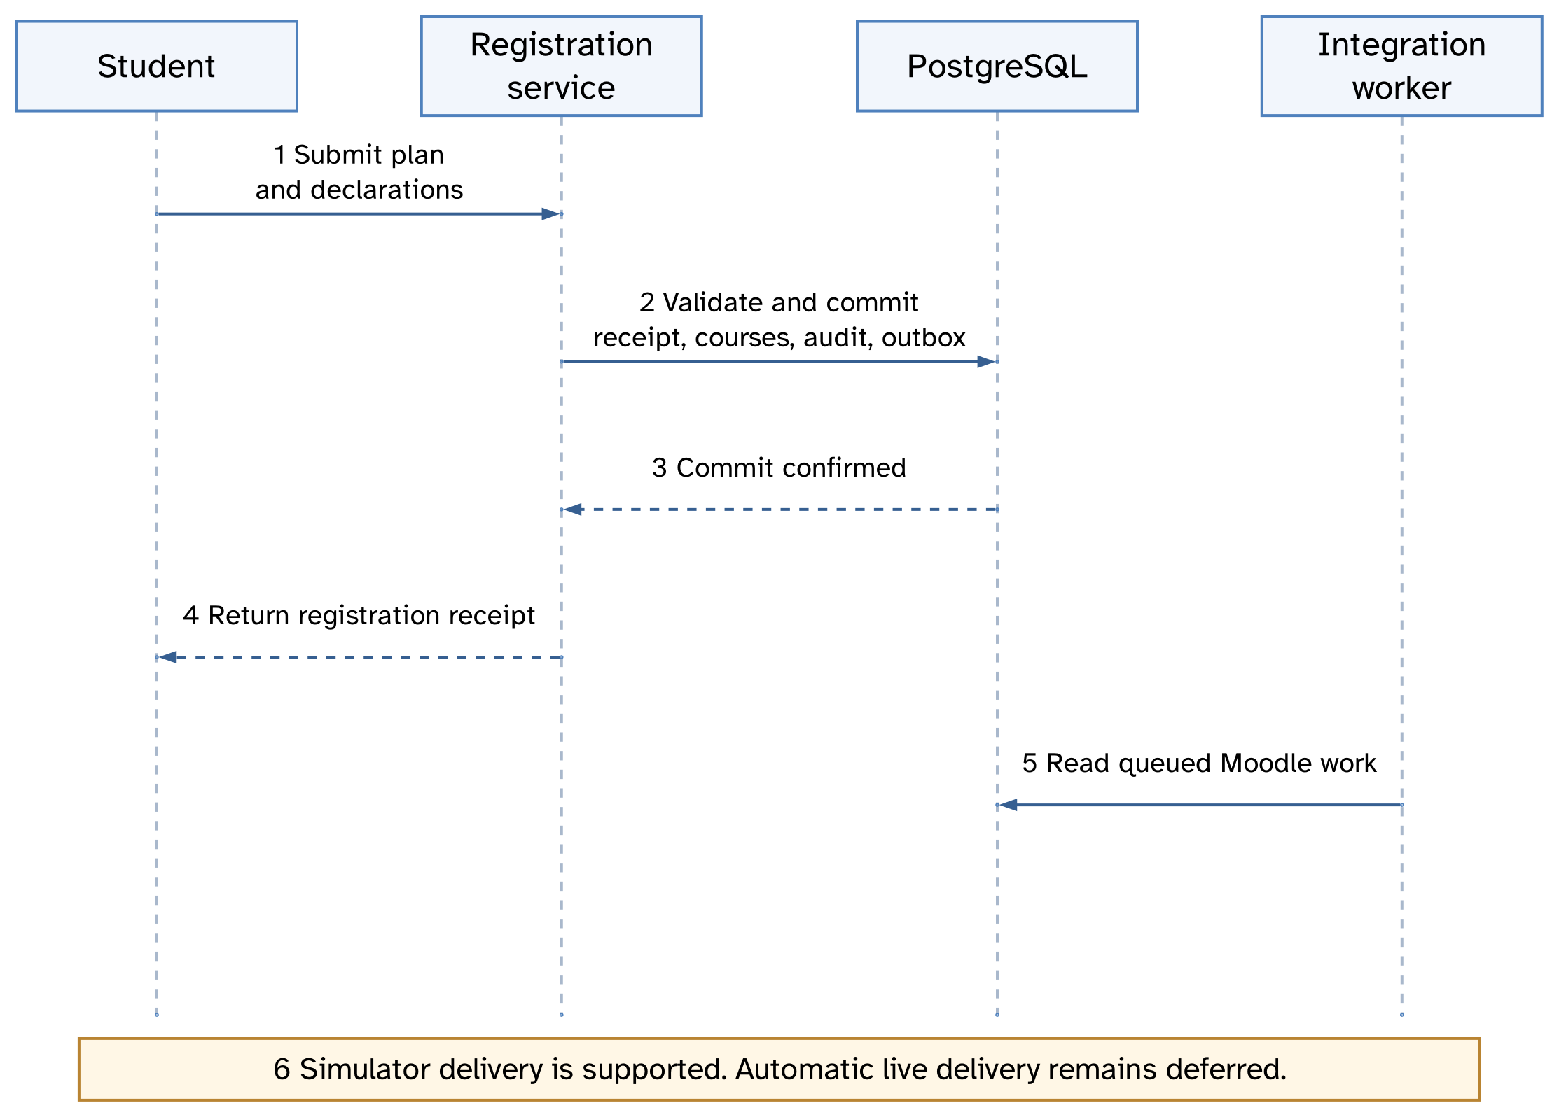
REGISTRATION SEQUENCE
A Moodle delay does not undo a valid registration.
Notes:
A Moodle delay does not undo a valid registration.
Presentation view: Full screenshot.
Capture source: Selected presentation view derived from the source-audited project diagrams included in the report and diagram atlas. Selected sequence after an authorised request. The real implementation includes controller dispatch and more policy, replay and transaction checks. Local evidence commits before separate worker delivery. No automatic live delivery is claimed.
Evidence type: Software engineering design of the implemented checkpoint; selected scope, with unfinished live integration labelled.
The captured state shows the workflow at the time of capture. It does not establish completion of every later transition.

Slide 20
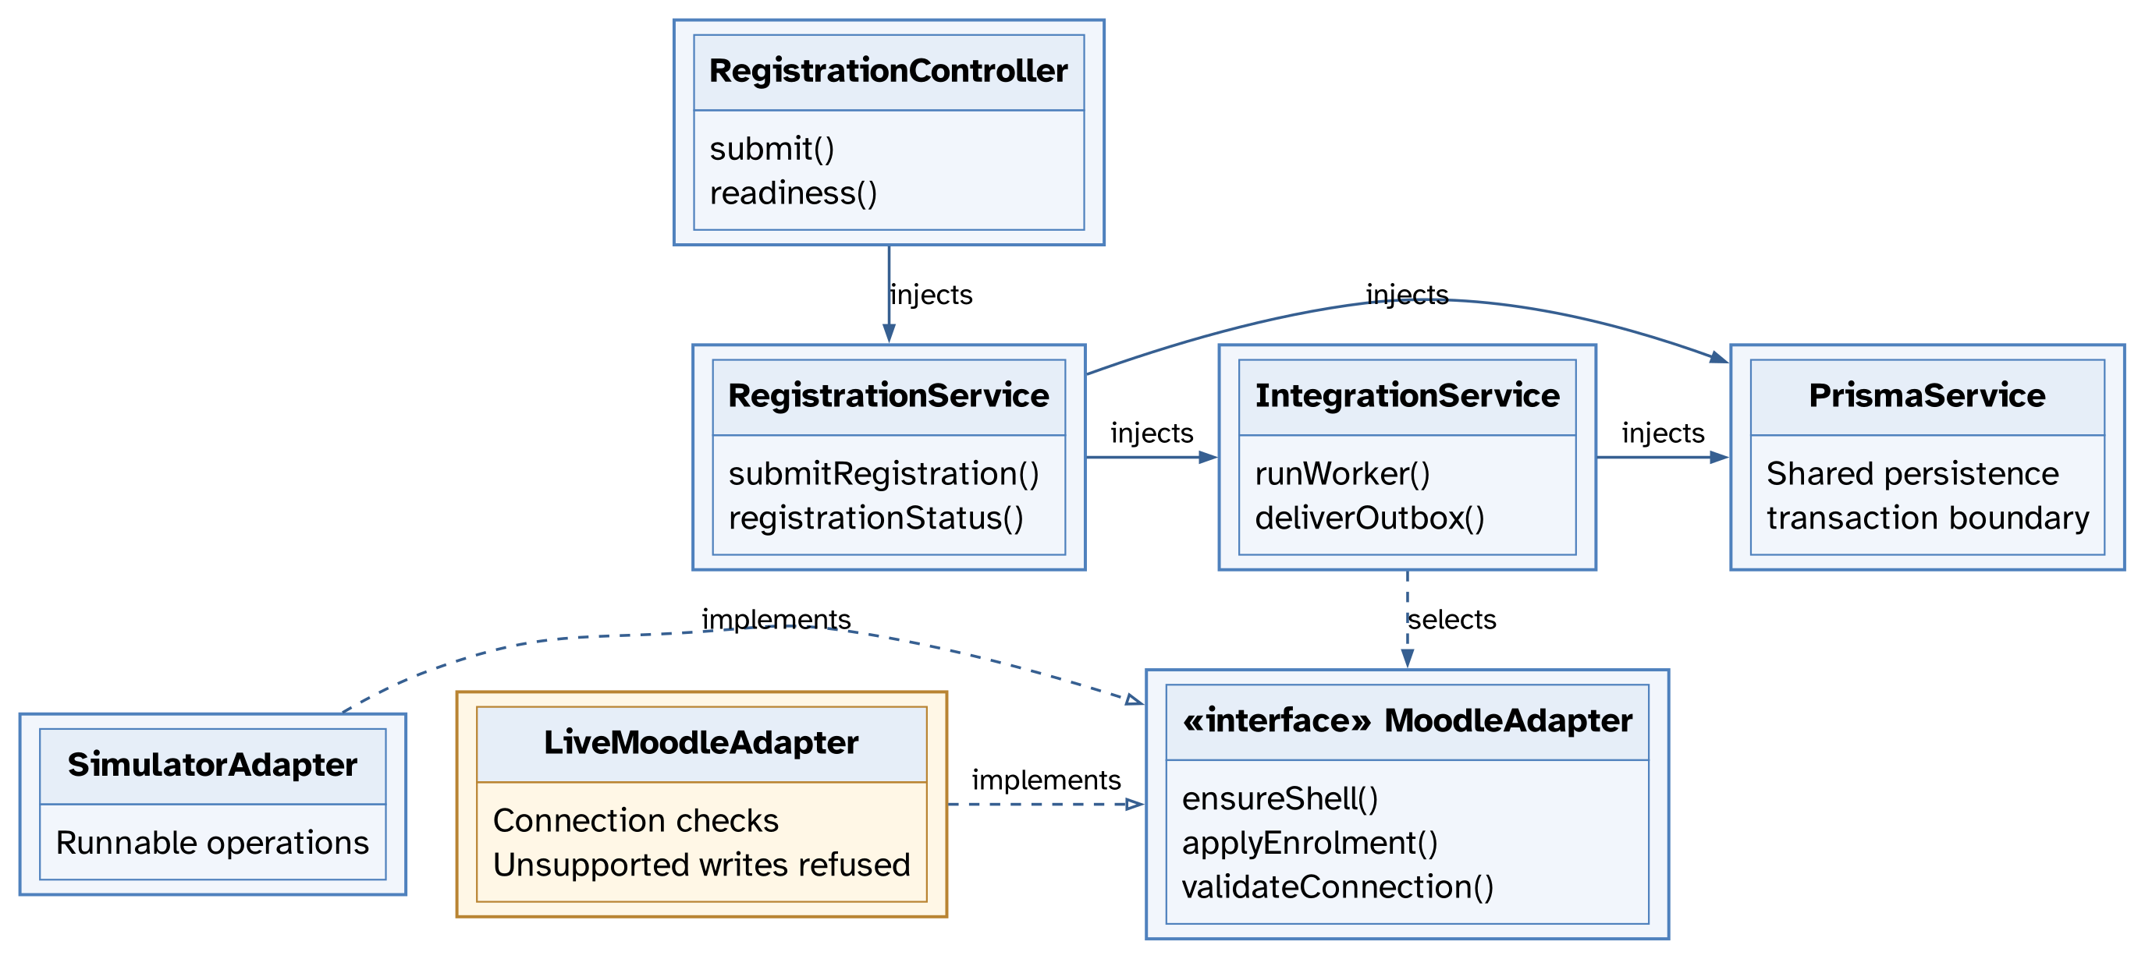
DESIGN CLASS DIAGRAM
Controllers call services; adapters isolate delivery.
Notes:
Controllers call services; adapters isolate delivery.
Presentation view: Full screenshot.
Capture source: Selected presentation view derived from the source-audited project diagrams included in the report and diagram atlas. Selected actual constructor dependencies and adapter realisation. Other dependencies such as FinanceService and OpsService are omitted for presentation. LiveMoodleAdapter validates connection but refuses unsupported write operations.
Evidence type: Software engineering design of the implemented checkpoint; selected scope, with unfinished live integration labelled.
The captured state shows the workflow at the time of capture. It does not establish completion of every later transition.

Slide 21
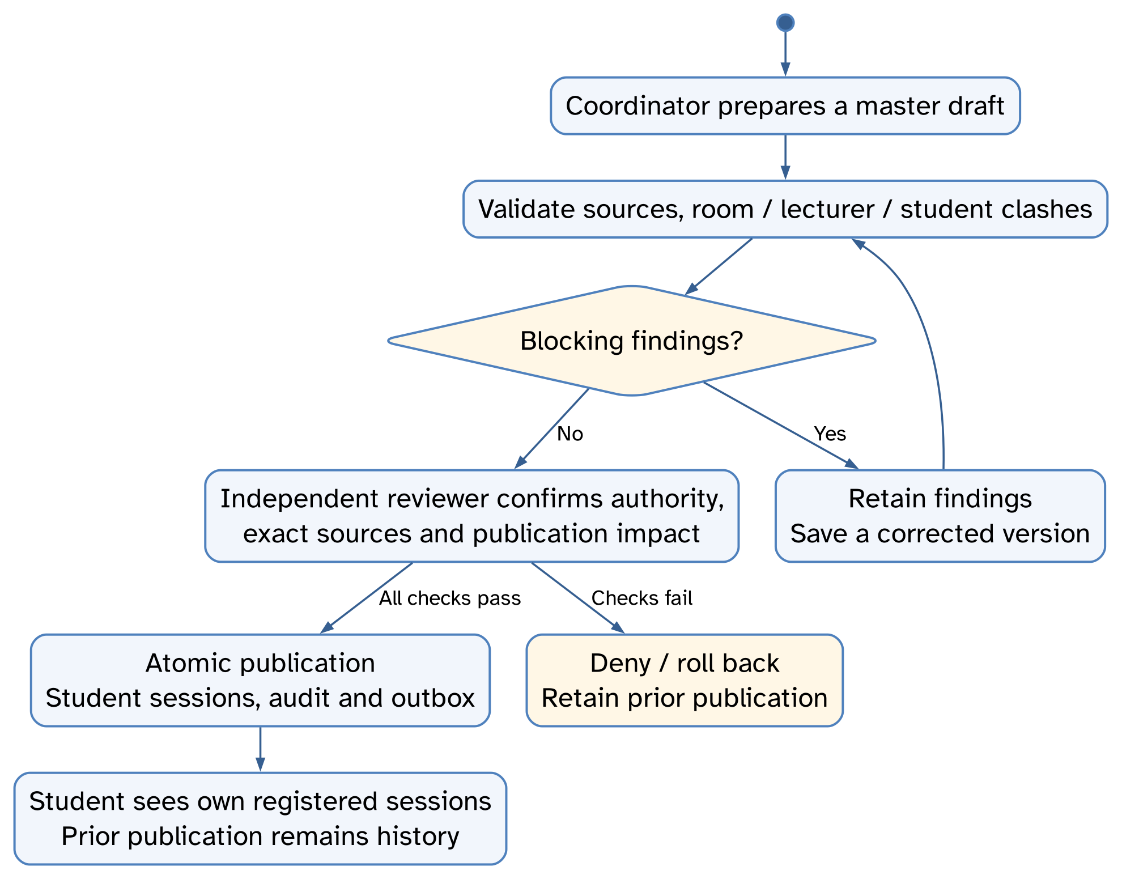
TIMETABLE PUBLICATION
Independent review precedes publication.
Notes:
Independent review precedes publication.
Presentation view: Full screenshot.
Capture source: Selected presentation view derived from the source-audited project diagrams included in the report and diagram atlas. Selected activity flow for the synthetic timetable workflow, including validation, corrected versions, independent review, atomic student projections and preservation of prior publication on rejection. Detailed credentials and final source rechecks are in the full engineering record.
Evidence type: Software engineering design of the implemented checkpoint; selected scope, with unfinished live integration labelled.
The captured state shows the workflow at the time of capture. It does not establish completion of every later transition.

Slide 22
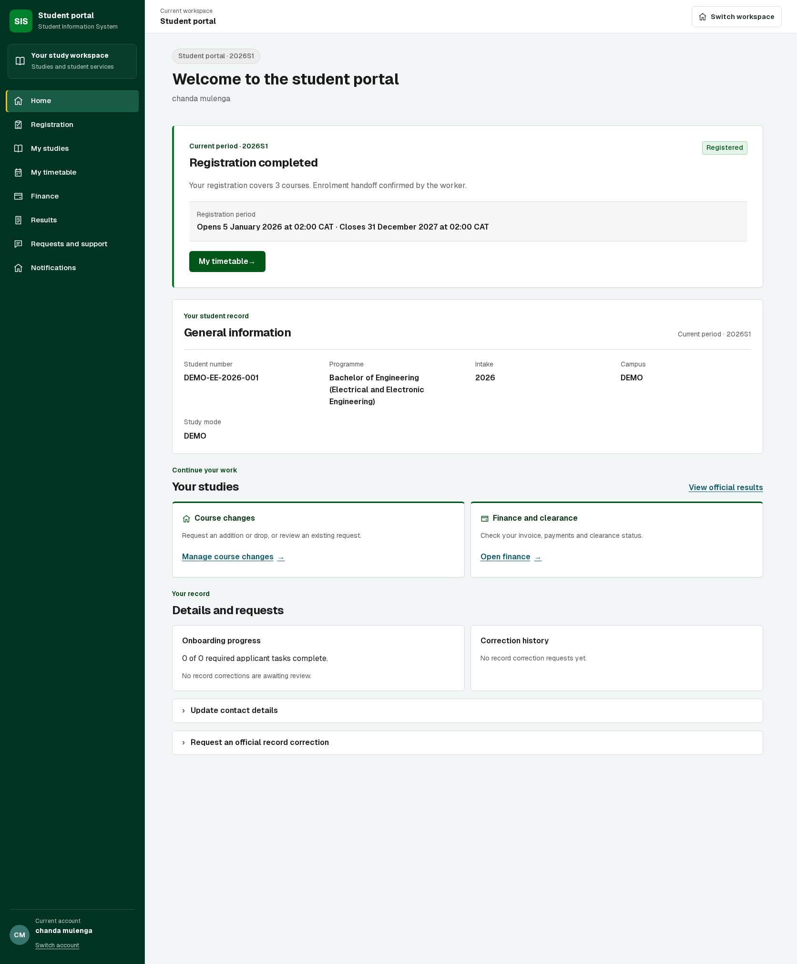
RESULTS AND DISCUSSION (1/4)
Complete capture. Enlarged page details follow the references.
Notes:
Our fully loaded local student portal, captured 16 October 2026 using the connected local API and isolated review database. It shows a completed registration and three courses. The worker handoff shown is the local simulator pathway, not automatic live MoodleCloud delivery. The local checkpoint remains separate from the earlier deployed release.

Slide 23
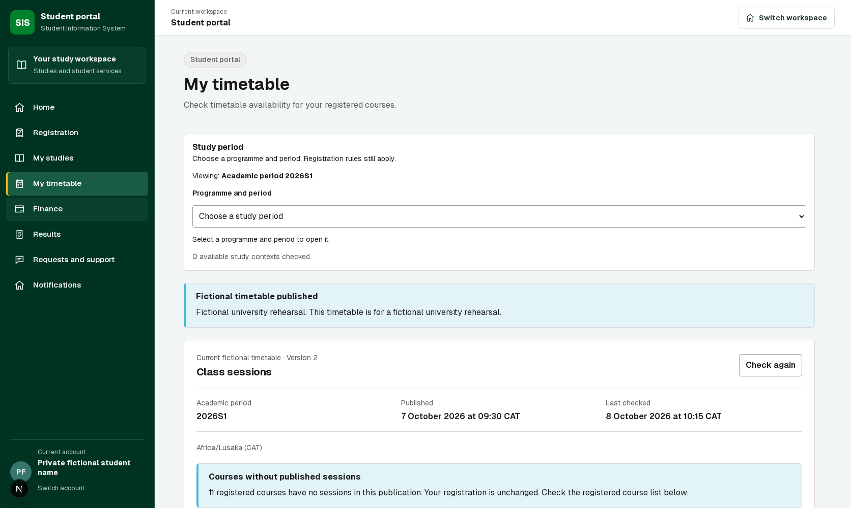
RESULTS AND DISCUSSION (2/4)
Notes:
Controlled browser fixture screenshot showing the personal timetable interface. The fixture demonstrates interface layout. Separate connected workflow evidence covers nine prepared registrations and a 12-session master timetable. This image itself does not establish a live MoodleCloud timetable.

Slide 24
RESULTS AND DISCUSSION (3/4)
We created 12 visible MoodleCloud courses and four demonstration accounts.
We verified 48 course memberships across those accounts.
A learner signed in normally, saw all 12 courses and opened a course.
Automatic live synchronisation and grade delivery still require completion.
Notes:
Provisioning evidence records 12 visible MoodleCloud course shells, four generated accounts and 48 memberships. The user confirmed normal Moodle learner login shows all 12 courses and a course opens. This is separate provisioning, not proof of automatic bidirectional SIS delivery, grade return or SSO.

Slide 25
RESULTS AND DISCUSSION (4/4)
Our prepared SIS dataset completed nine registrations through the API.
Published timetables project relevant sessions to each registered student.
Registration failures preserve actionable validation messages and supporting evidence.
The latest student UI is a local checkpoint, separate from the earlier deployed release.
Notes:
Prepared supervisor review dataset: nine registration transactions and a 12-session master timetable. Published student projections show sessions belonging to registered courses. Latest sidebar/auth UI changes remain a local checkpoint pending final integration verification.

Slide 26
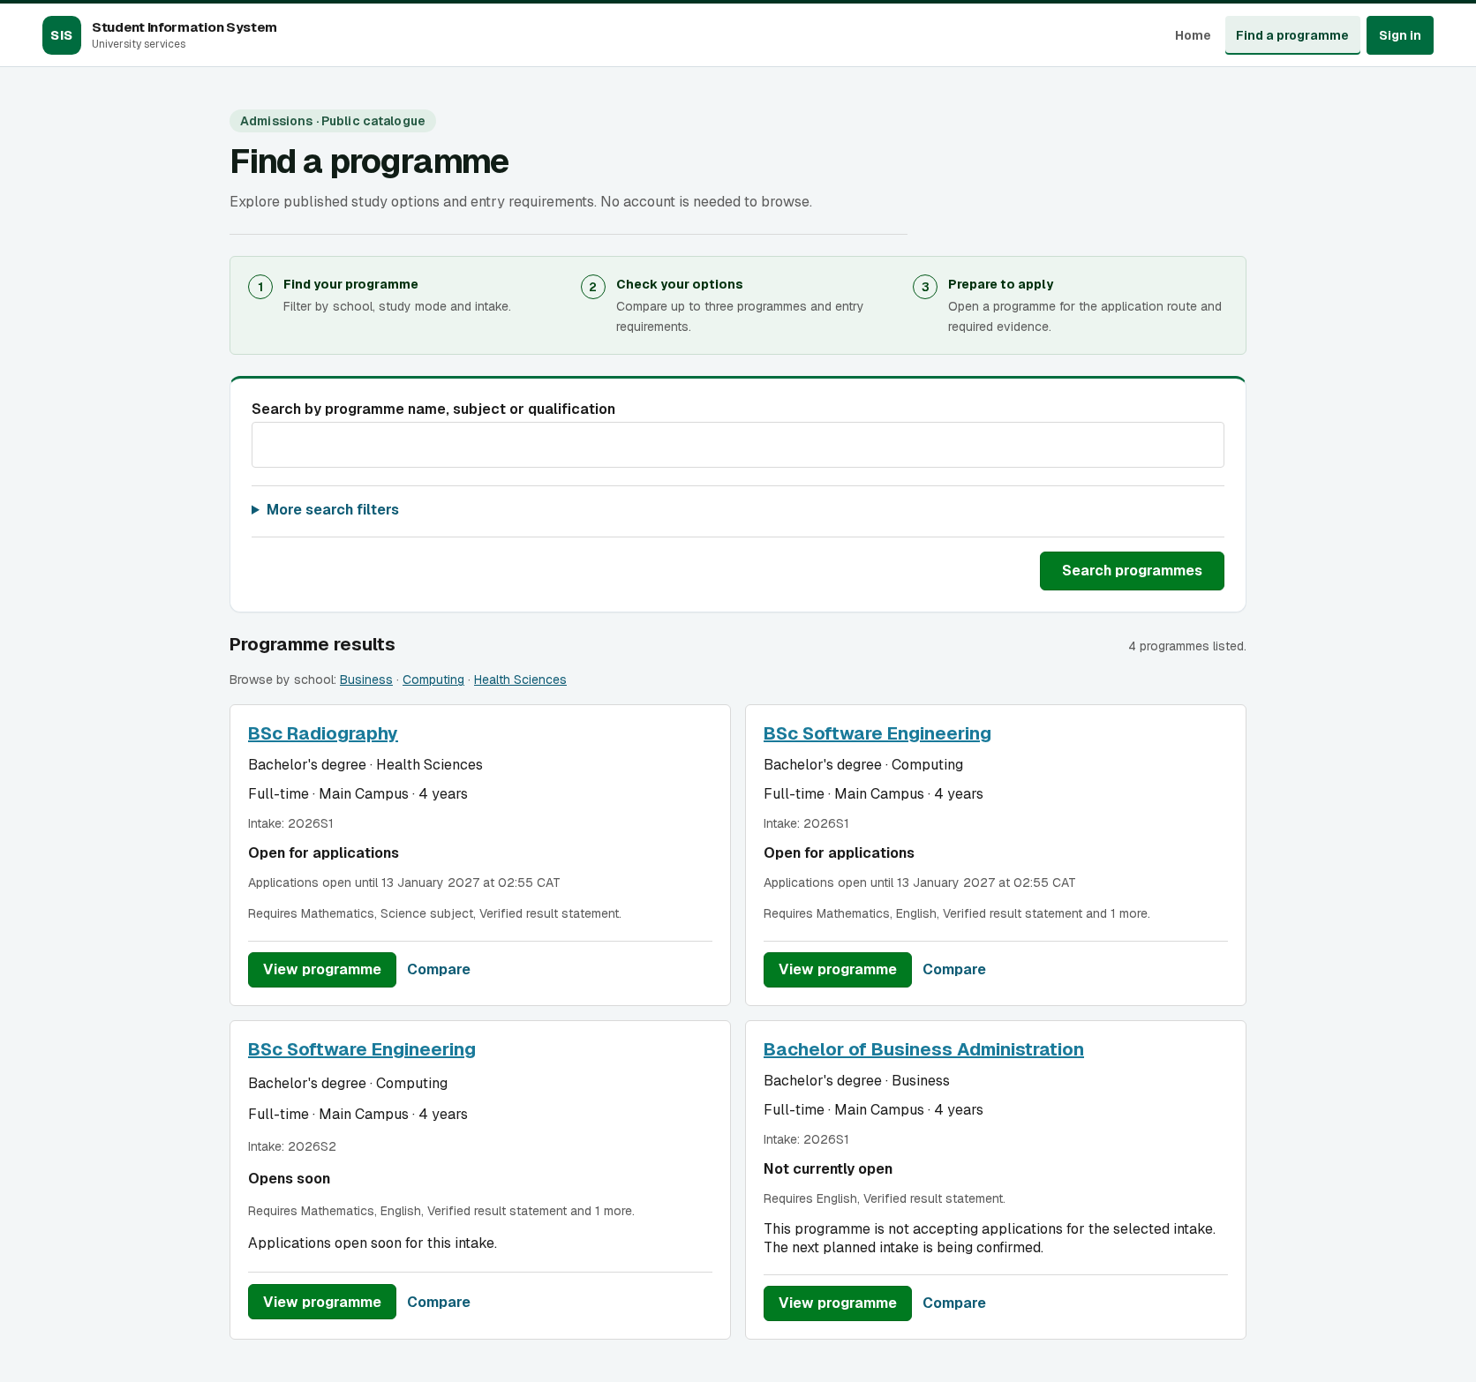
4.1 PROGRAMME CATALOGUE
Complete capture. Enlarged page details follow the references.
Notes:
Programme catalogue search, filters and programme cards.
Presentation view: Complete uncropped source capture. Full-width numbered continuation views in the appendix preserve every part of long pages.
Capture source: /home/hangoma/SIS-INTEGRATED-WITH-MOODLE/.worktree/phase7-completion/.worktree/github-release-20261012/.local-release/portal-all-ui-discover-1672.png
Evidence type: Connected local API and isolated review database; .local-release/portal-all-ui-review.mjs
The captured state shows the workflow at the time of capture. It does not establish completion of every later transition.

Slide 27
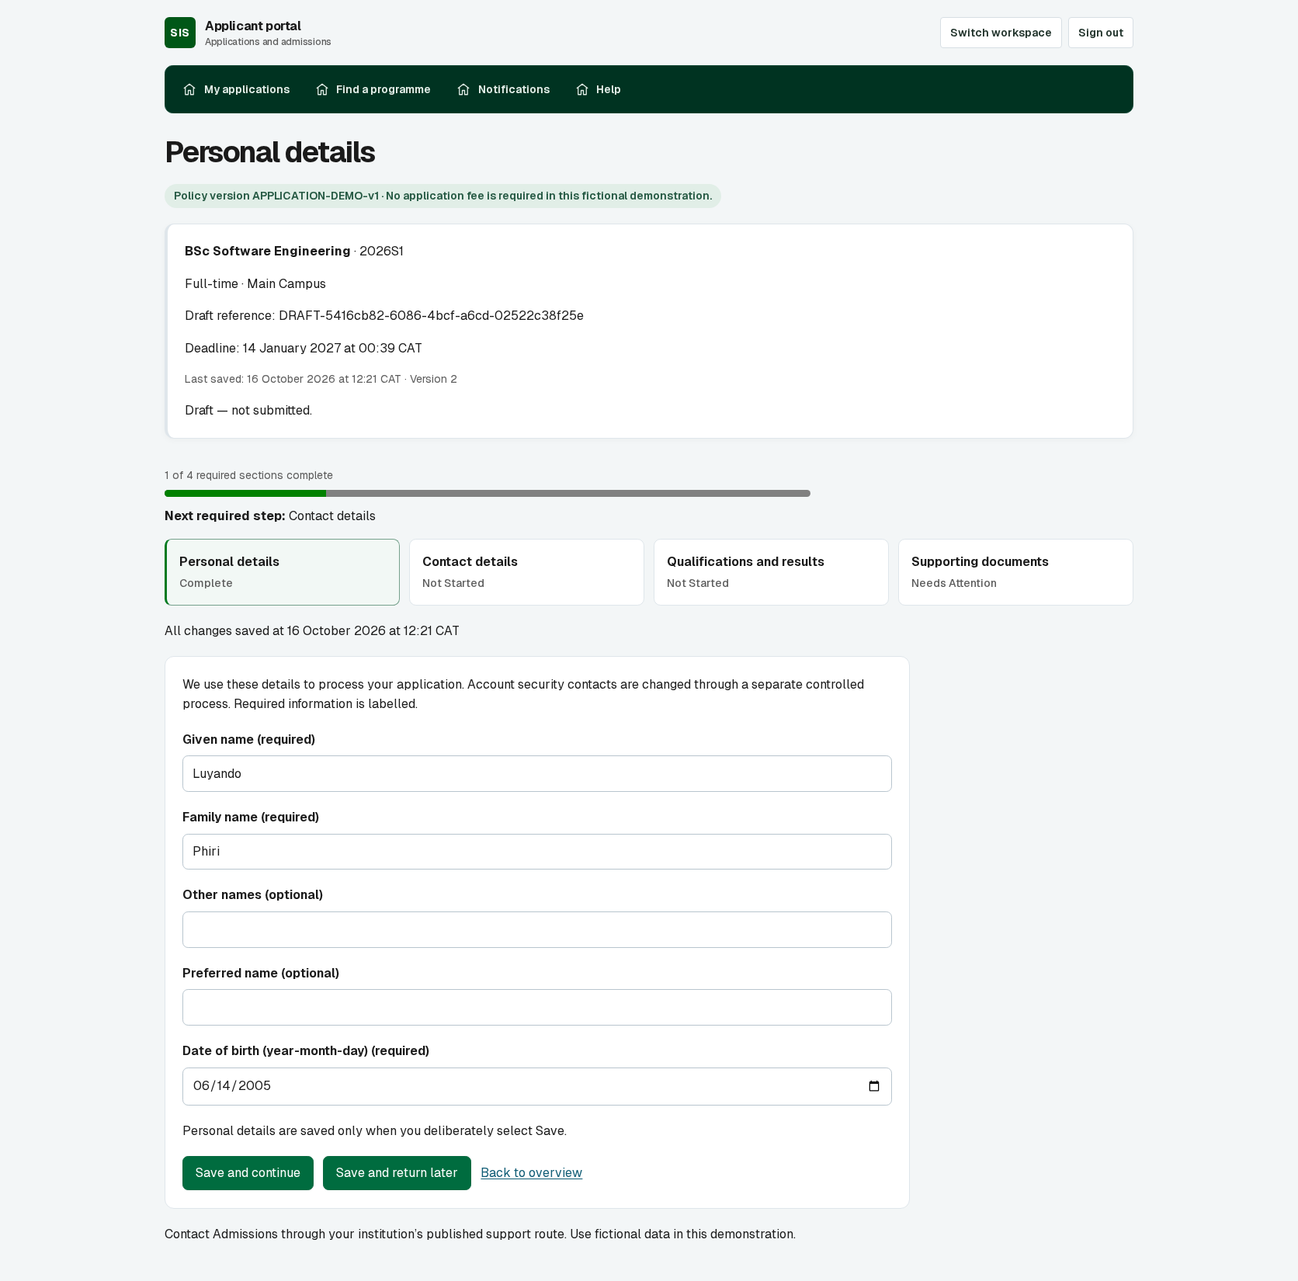
4.2 APPLICATION DRAFT
Complete capture. Enlarged page details follow the references.
Notes:
Applicant personal-details form, persisted name and draft progress; supporting-documents screenshot retained separately.
Presentation view: Complete uncropped source capture. Full-width numbered continuation views in the appendix preserve every part of long pages.
Capture source: Fresh connected local capture 16 October 2026; isolated supervisor review database
Evidence type: New createApplicant fixture; normal discovery/start application, sign-in, personal-details save and return navigation. No network mocks; saved values verified after navigation.
The captured state shows the workflow at the time of capture. It does not establish completion of every later transition.

Slide 28
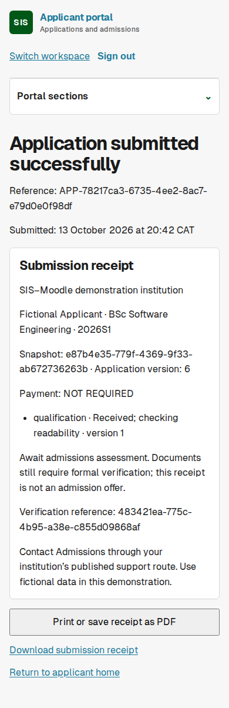
4.3 SUBMISSION RECEIPT
Complete capture. Enlarged page details follow the references.
Notes:
Successful submission, immutable receipt and download action; mobile capture.
Presentation view: Complete uncropped source capture. Full-width numbered continuation views in the appendix preserve every part of long pages.
Capture source: /home/hangoma/SIS-INTEGRATED-WITH-MOODLE/.worktree/phase7-completion/.worktree/github-release-20261012/.local-release/browser-evidence-38447432657/test-results/applicant-receipt-mobile.png
Evidence type: Connected browser integration test applicant.spec.ts; successful submission confirmed after lost-response recovery.
The captured state shows the workflow at the time of capture. It does not establish completion of every later transition.

Slide 29
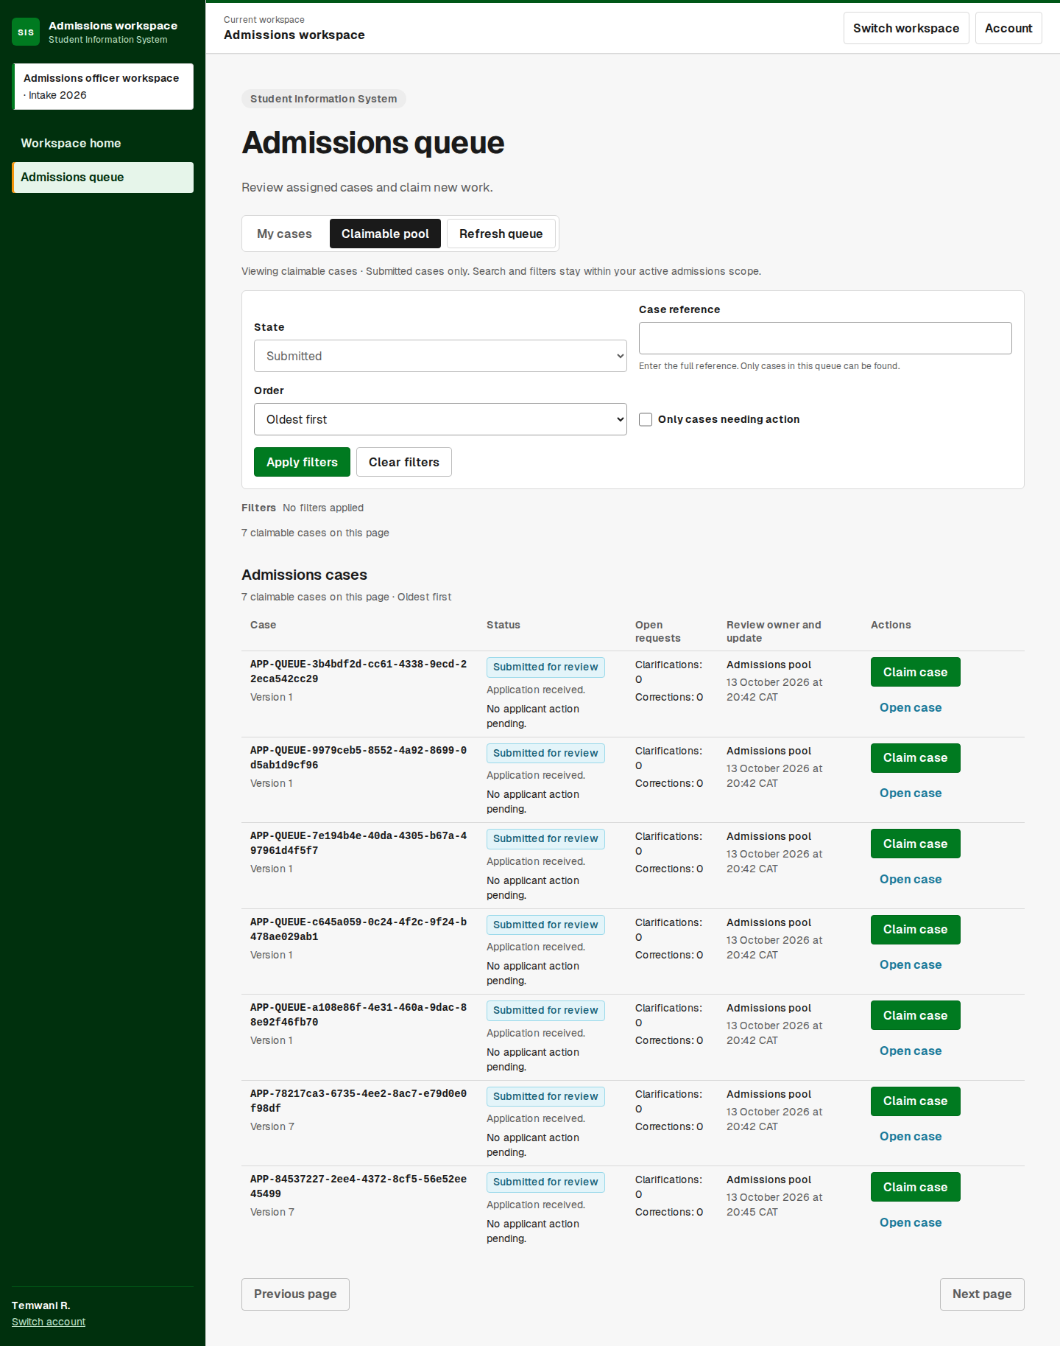
4.4 ADMISSIONS QUEUE
Complete capture. Enlarged page details follow the references.
Notes:
Claimable application queue and staff ownership workflow.
Presentation view: Complete uncropped source capture. Full-width numbered continuation views in the appendix preserve every part of long pages.
Capture source: /home/hangoma/SIS-INTEGRATED-WITH-MOODLE/.worktree/phase7-completion/.worktree/github-release-20261012/.local-release/browser-evidence-38447432657/test-results/ui-admissions-queue-1440.png
Evidence type: Connected browser integration test ui-admissions-workspace.visual.spec.ts; actual application submitted and staff signed in.
The captured state shows the workflow at the time of capture. It does not establish completion of every later transition.

Slide 30
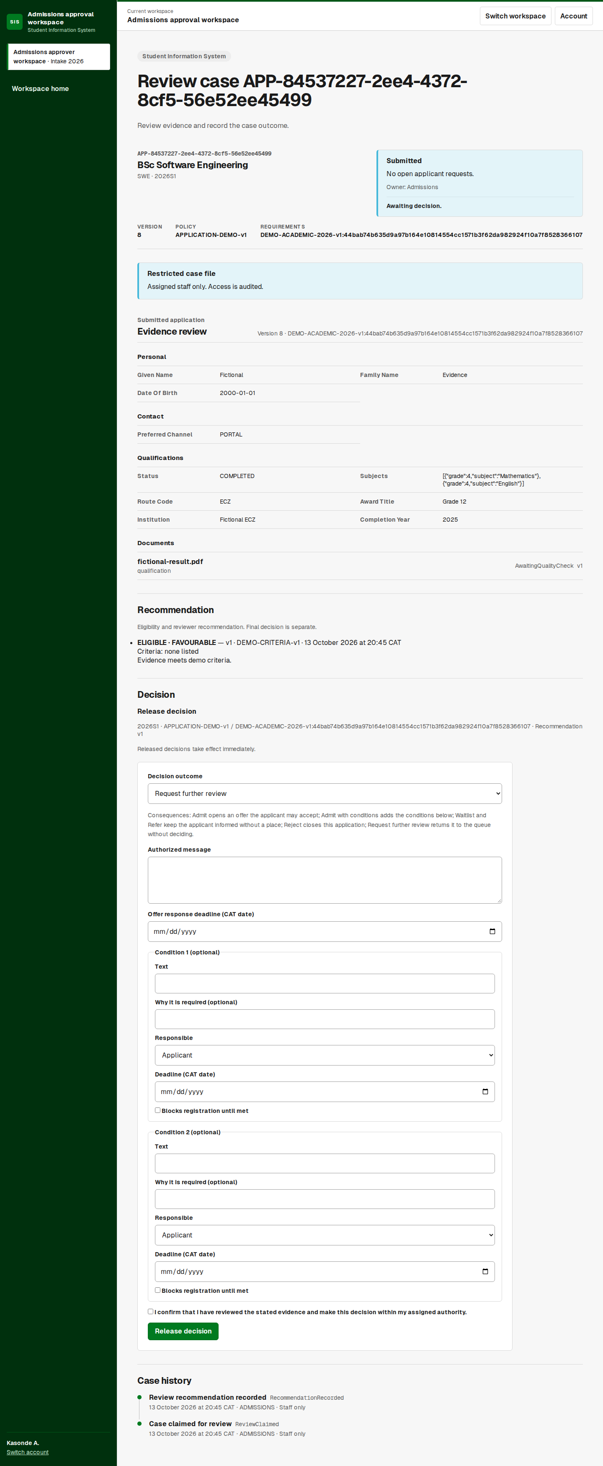
4.5 REVIEW DECISION
Complete capture. Enlarged page details follow the references.
Notes:
Application evidence, favourable recommendation, decision form and case history. Decision has not yet been released in this capture.
Presentation view: Complete uncropped source capture. Full-width numbered continuation views in the appendix preserve every part of long pages.
Capture source: /home/hangoma/SIS-INTEGRATED-WITH-MOODLE/.worktree/phase7-completion/.worktree/github-release-20261012/.local-release/browser-evidence-38447432657/test-results/ui-admissions-approver-case-1440.png
Evidence type: Connected browser integration test ui-admissions-workspace.visual.spec.ts; independent approver after recorded reviewer recommendation.
The captured state shows the workflow at the time of capture. It does not establish completion of every later transition.

Slide 31
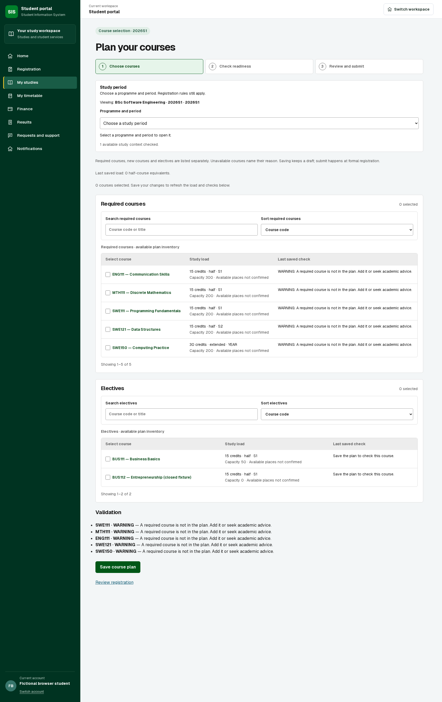
4.6 COURSE REGISTRATION
Complete capture. Enlarged page details follow the references.
Notes:
Editable course plan with required courses, search and sorting. Saving a draft is separate from formal submission.
Presentation view: Full screenshot.
Capture source: Local review application http://127.0.0.1:3160 backed by isolated sis_supervisor_review_20261016 database
Evidence type: Fresh connected capture on16October2026; isolated supervisor review database; new generated student; no API mocks.
The captured state shows the workflow at the time of capture. It does not establish completion of every later transition.

Slide 32
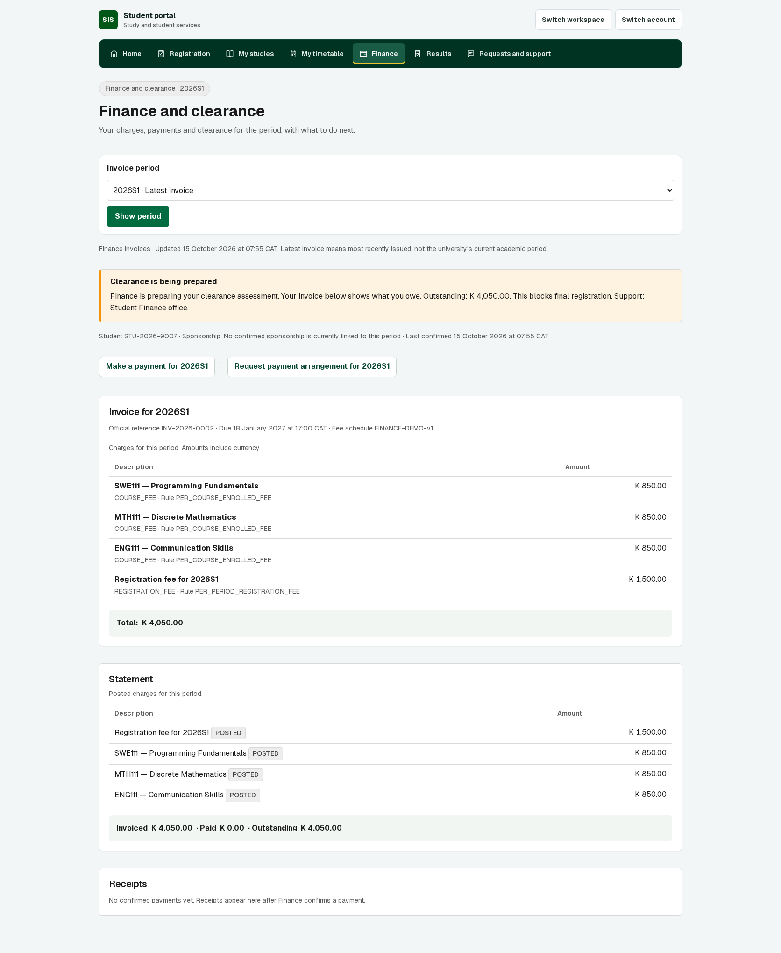
4.7 STUDENT FINANCE
Complete capture. Enlarged page details follow the references.
Notes:
Itemised invoice, statement and payment routes; clearance pending, no live payment claim.
Presentation view: Complete uncropped source capture. Full-width numbered continuation views in the appendix preserve every part of long pages.
Capture source: /home/hangoma/SIS-INTEGRATED-WITH-MOODLE/.worktree/phase7-completion/.worktree/github-release-20261012/.local-release/portal-all-ui-student-finance-1672.png
Evidence type: Connected API; .local-release/portal-all-ui-review.mjs creates student and assesses synthetic charges.
The captured state shows the workflow at the time of capture. It does not establish completion of every later transition.

Slide 33
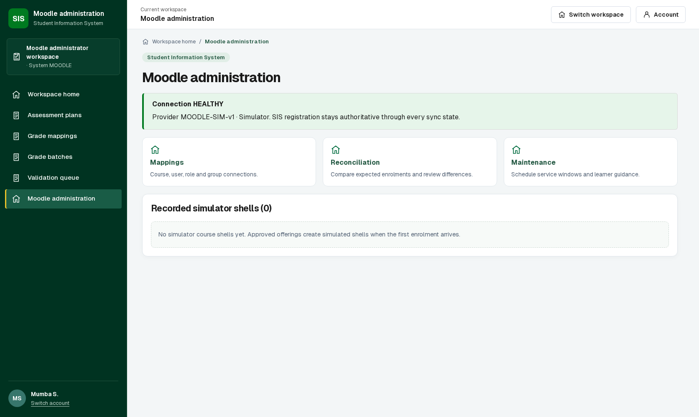
4.8 MOODLE DASHBOARD
Complete capture. Enlarged page details follow the references.
Notes:
Healthy simulator connection and mappings/reconciliation/maintenance workspaces; zero recorded shells in this screenshot.
Presentation view: Full screenshot.
Capture source: /home/hangoma/SIS-INTEGRATED-WITH-MOODLE/.worktree/phase7-completion/.worktree/github-release-20261012/.local-release/staff-all-ui-moodle-1672.png
Evidence type: Connected API; .local-release/staff-all-ui-review.mjs; simulator mode.
The captured state shows the workflow at the time of capture. It does not establish completion of every later transition.

Slide 34
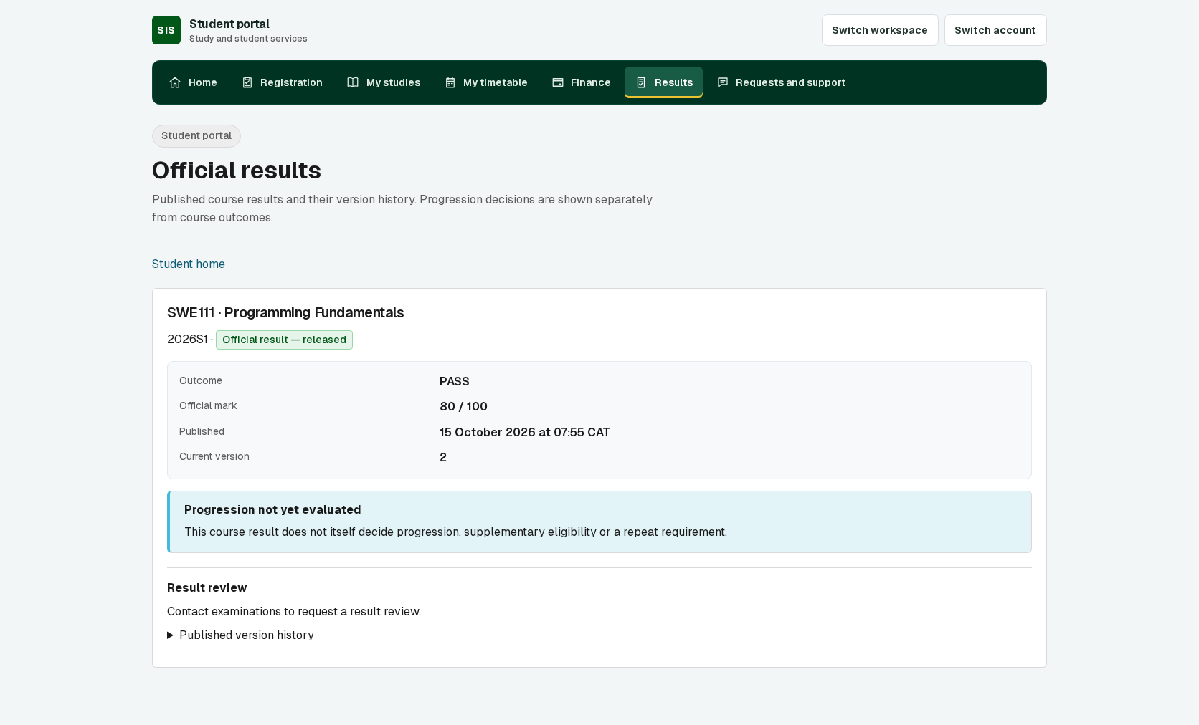
4.9 ASSESSMENT RESULTS
Complete capture. Enlarged page details follow the references.
Notes:
Published result display and version history. Does not evidence a completed staging-to-release workflow.
Presentation view: Full screenshot.
Capture source: /home/hangoma/SIS-INTEGRATED-WITH-MOODLE/.worktree/phase7-completion/.worktree/github-release-20261012/.local-release/portal-all-ui-student-results-1672.png
Evidence type: Connected API rendering; .local-release/portal-all-ui-review.mjs directly seeds OfficialResultVersion review rows.
The captured state shows the workflow at the time of capture. It does not establish completion of every later transition.

Slide 35
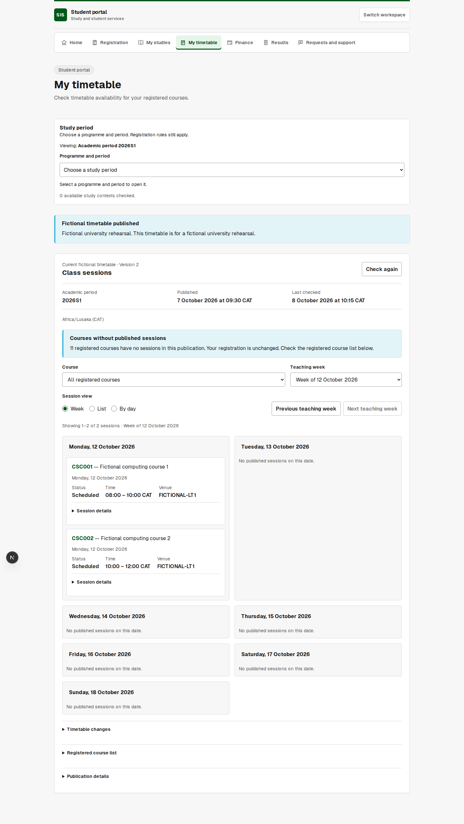
4.10 STUDENT TIMETABLE
Complete capture. Enlarged page details follow the references.
Notes:
Week view with dated sessions, venues, course filter, list alternative and changes.
Presentation view: Complete uncropped source capture. Full-width numbered continuation views in the appendix preserve every part of long pages.
Capture source: /home/hangoma/SIS-INTEGRATED-WITH-MOODLE/.worktree/phase7-completion/.worktree/github-release-20261012/.local-release/browser-evidence-38447432657/test-results/student-timetable-availabi-59770-ords-and-a-list-alternative/published-timetable-week-desktop.png
Evidence type: Controlled API-response UI browser test student-timetable-availability.spec.ts; not connected publication evidence.
The captured state shows the workflow at the time of capture. It does not establish completion of every later transition.

Slide 36
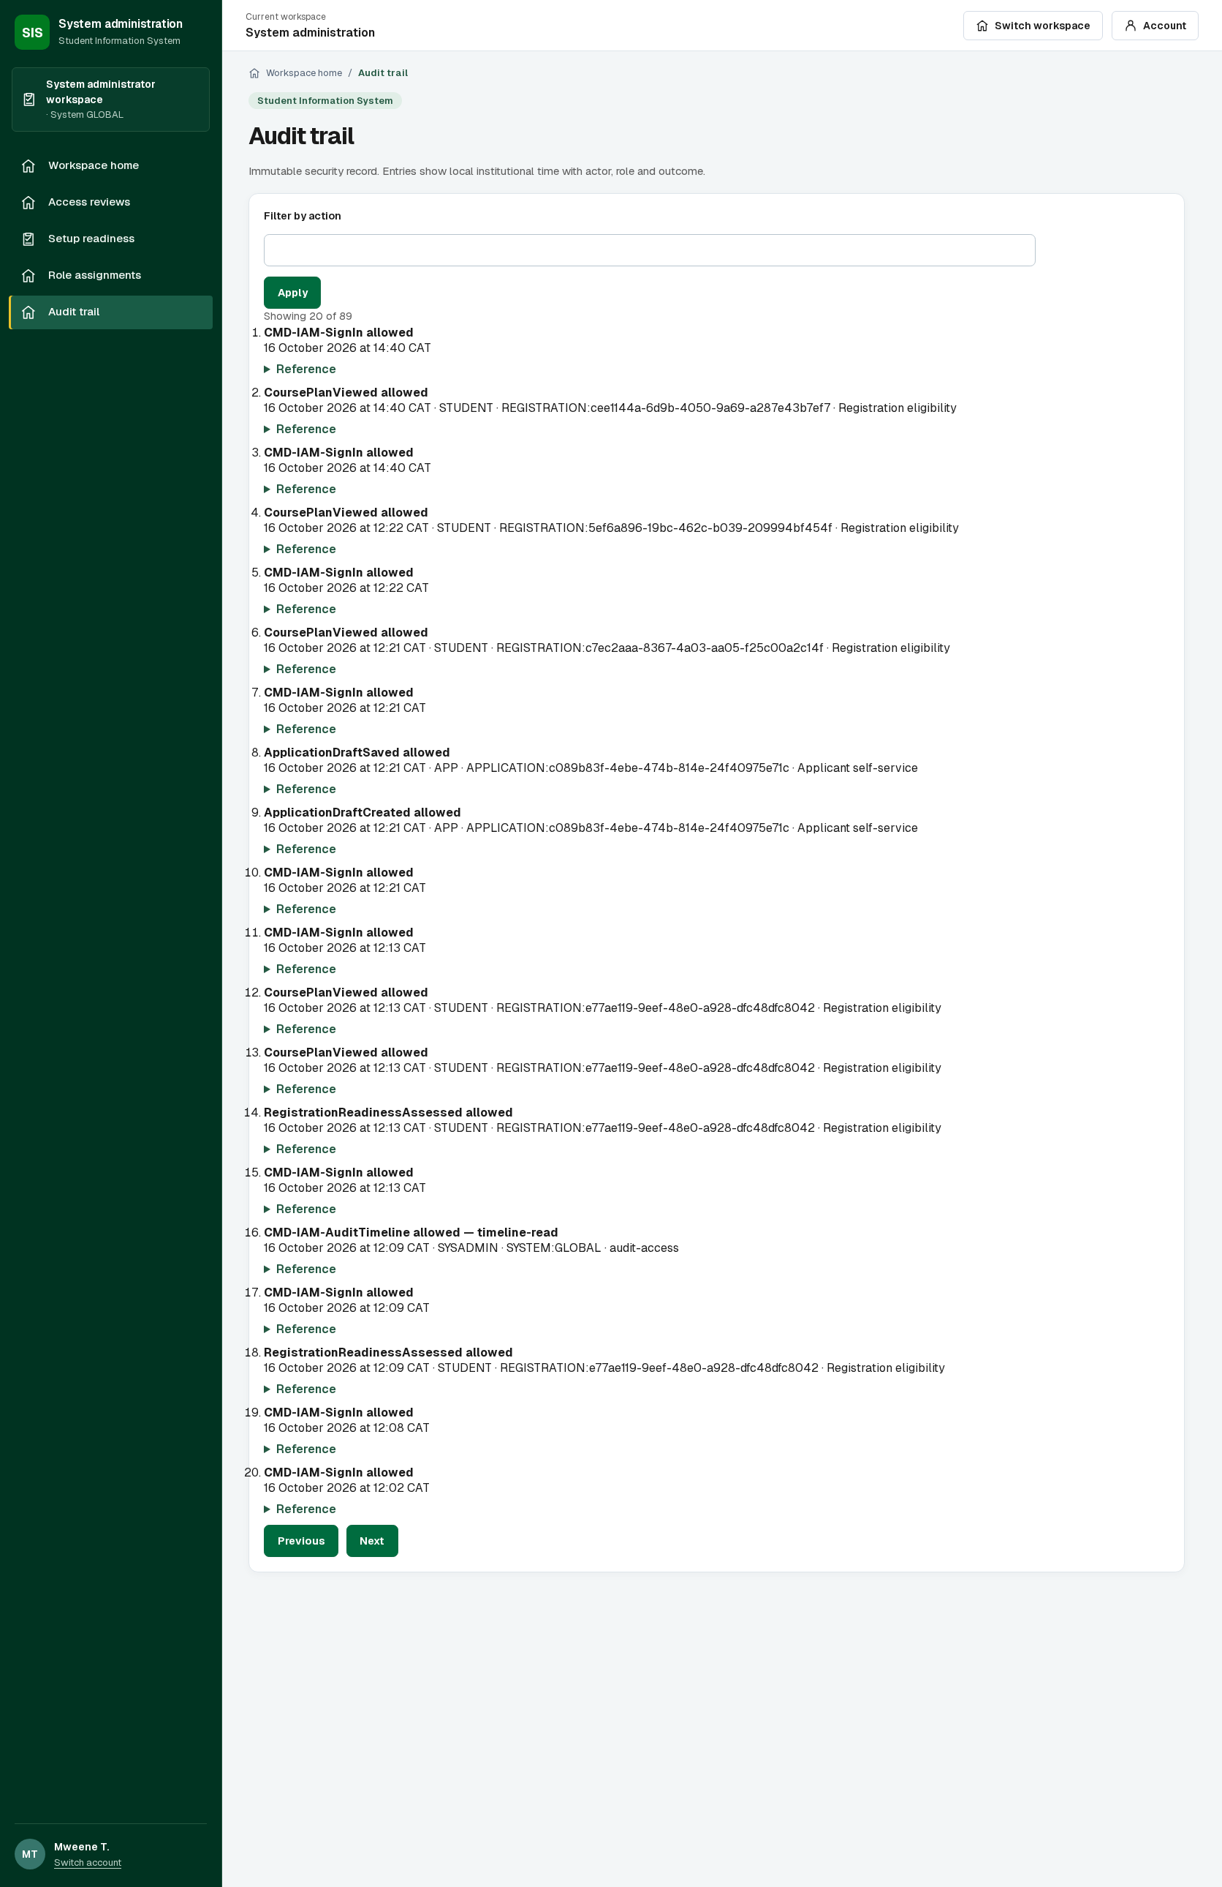
4.11 AUDIT AND OPERATIONS
Complete capture. Enlarged page details follow the references.
Notes:
Persisted security events with actor, role and outcome. Companion operations dashboard is included in the folder.
Presentation view: Full screenshot.
Capture source: Local review application http://127.0.0.1:3160 backed by isolated sis_supervisor_review_20261016 database
Evidence type: Fresh connected capture on16October2026; SYSADMIN workspace; actual local API and PostgreSQL records, no mocks.
The captured state shows the workflow at the time of capture. It does not establish completion of every later transition.

Slide 37
CONCLUSION
We built a modular SIS with controlled registration, assessment and timetable workflows.
We demonstrated external MoodleCloud course creation and learner access.
Our main contribution is the separation of authoritative academic decisions from recoverable integration work.
The project remains a demonstrator with identified integration and AI work outstanding.
Notes:
We explain the design and implementation described on this slide. Our evidence is the project handbook and implementation checkpoint dated 16 October 2026.

Slide 38
RECOMMENDATIONS
Complete automatic Moodle delivery and reconciliation before claiming end-to-end live synchronisation.
Implement and evaluate LTI launch and the governed student assistant.
Conduct supervised user acceptance, accessibility and recovery exercises.
Confirm institutional policies before operational adoption.
Notes:
We explain the design and implementation described on this slide. Our evidence is the project handbook and implementation checkpoint dated 16 October 2026.

Slide 39
REFERENCES
Moodle. Web services and External Services API documentation. MoodleDocs and Moodle Developer Resources. Accessed 16 October 2026.
1EdTech Consortium. Learning Tools Interoperability Core Specification 1.3. Final Release, 2019.
NIST. Artificial Intelligence Risk Management Framework (AI RMF 1.0). NIST AI 100-1, 2023. DOI: 10.6028/NIST.AI.100-1.
Project evidence: our handbook, implementation records and verification logs, checkpoint 16 October 2026.
Notes:
[1] https://docs.moodle.org/503/en/Using_web_services. [2] https://www.imsglobal.org/spec/lti/v1p3/. [3] https://doi.org/10.6028/NIST.AI.100-1. Internal evidence: repository handbook, docs/supervisor/VERIFICATION.json and our implementation logs. We excluded unverifiable placeholder citations in our original proposal.

Slide 40
CATALOGUE 1/2
Reference appendix · full-width page continuation 1 of 2
Notes:
Optional enlarged reference view. The complete uncropped page appears in the main presentation. These numbered overlapping continuations cover the original image from top to bottom without omitting either side. Source: 4.1-programme-catalogue.png. Evidence: Connected local API and isolated review database; .local-release/portal-all-ui-review.mjs

Slide 41
CATALOGUE 2/2
Reference appendix · full-width page continuation 2 of 2
Notes:
Optional enlarged reference view. The complete uncropped page appears in the main presentation. These numbered overlapping continuations cover the original image from top to bottom without omitting either side. Source: 4.1-programme-catalogue.png. Evidence: Connected local API and isolated review database; .local-release/portal-all-ui-review.mjs

Slide 42
APPLICATION 1/2
Reference appendix · full-width page continuation 1 of 2
Notes:
Optional enlarged reference view. The complete uncropped page appears in the main presentation. These numbered overlapping continuations cover the original image from top to bottom without omitting either side. Source: 4.2-application-form-saved-draft.png. Evidence: New createApplicant fixture; normal discovery/start application, sign-in, personal-details save and return navigation. No network mocks; saved values verified after navigation.

Slide 43
APPLICATION 2/2
Reference appendix · full-width page continuation 2 of 2
Notes:
Optional enlarged reference view. The complete uncropped page appears in the main presentation. These numbered overlapping continuations cover the original image from top to bottom without omitting either side. Source: 4.2-application-form-saved-draft.png. Evidence: New createApplicant fixture; normal discovery/start application, sign-in, personal-details save and return navigation. No network mocks; saved values verified after navigation.

Slide 44
RECEIPT 1/2
Reference appendix · full-width page continuation 1 of 2
Notes:
Optional enlarged reference view. The complete uncropped page appears in the main presentation. These numbered overlapping continuations cover the original image from top to bottom without omitting either side. Source: 4.3-application-submission-receipt.png. Evidence: Connected browser integration test applicant.spec.ts; successful submission confirmed after lost-response recovery.

Slide 45
RECEIPT 2/2
Reference appendix · full-width page continuation 2 of 2
Notes:
Optional enlarged reference view. The complete uncropped page appears in the main presentation. These numbered overlapping continuations cover the original image from top to bottom without omitting either side. Source: 4.3-application-submission-receipt.png. Evidence: Connected browser integration test applicant.spec.ts; successful submission confirmed after lost-response recovery.

Slide 46
ADMISSIONS QUEUE 1/2
Reference appendix · full-width page continuation 1 of 2
Notes:
Optional enlarged reference view. The complete uncropped page appears in the main presentation. These numbered overlapping continuations cover the original image from top to bottom without omitting either side. Source: 4.4-admissions-queue.png. Evidence: Connected browser integration test ui-admissions-workspace.visual.spec.ts; actual application submitted and staff signed in.

Slide 47
ADMISSIONS QUEUE 2/2
Reference appendix · full-width page continuation 2 of 2
Notes:
Optional enlarged reference view. The complete uncropped page appears in the main presentation. These numbered overlapping continuations cover the original image from top to bottom without omitting either side. Source: 4.4-admissions-queue.png. Evidence: Connected browser integration test ui-admissions-workspace.visual.spec.ts; actual application submitted and staff signed in.

Slide 48
REVIEW DECISION 1/4
Reference appendix · full-width page continuation 1 of 4
Notes:
Optional enlarged reference view. The complete uncropped page appears in the main presentation. These numbered overlapping continuations cover the original image from top to bottom without omitting either side. Source: 4.5-admissions-review-and-decision.png. Evidence: Connected browser integration test ui-admissions-workspace.visual.spec.ts; independent approver after recorded reviewer recommendation.

Slide 49
REVIEW DECISION 2/4
Reference appendix · full-width page continuation 2 of 4
Notes:
Optional enlarged reference view. The complete uncropped page appears in the main presentation. These numbered overlapping continuations cover the original image from top to bottom without omitting either side. Source: 4.5-admissions-review-and-decision.png. Evidence: Connected browser integration test ui-admissions-workspace.visual.spec.ts; independent approver after recorded reviewer recommendation.

Slide 50
REVIEW DECISION 3/4
Reference appendix · full-width page continuation 3 of 4
Notes:
Optional enlarged reference view. The complete uncropped page appears in the main presentation. These numbered overlapping continuations cover the original image from top to bottom without omitting either side. Source: 4.5-admissions-review-and-decision.png. Evidence: Connected browser integration test ui-admissions-workspace.visual.spec.ts; independent approver after recorded reviewer recommendation.

Slide 51
REVIEW DECISION 4/4
Reference appendix · full-width page continuation 4 of 4
Notes:
Optional enlarged reference view. The complete uncropped page appears in the main presentation. These numbered overlapping continuations cover the original image from top to bottom without omitting either side. Source: 4.5-admissions-review-and-decision.png. Evidence: Connected browser integration test ui-admissions-workspace.visual.spec.ts; independent approver after recorded reviewer recommendation.

Slide 52
COURSE SELECTION 1/3
Reference appendix · full-width page continuation 1 of 3
Notes:
Optional enlarged reference view. The complete uncropped page appears in the main presentation. These numbered overlapping continuations cover the original image from top to bottom without omitting either side. Source: 4.6-course-selection-draft.png. Evidence: Fresh connected capture on16October2026; isolated supervisor review database; new generated student; no API mocks.

Slide 53
COURSE SELECTION 2/3
Reference appendix · full-width page continuation 2 of 3
Notes:
Optional enlarged reference view. The complete uncropped page appears in the main presentation. These numbered overlapping continuations cover the original image from top to bottom without omitting either side. Source: 4.6-course-selection-draft.png. Evidence: Fresh connected capture on16October2026; isolated supervisor review database; new generated student; no API mocks.

Slide 54
COURSE SELECTION 3/3
Reference appendix · full-width page continuation 3 of 3
Notes:
Optional enlarged reference view. The complete uncropped page appears in the main presentation. These numbered overlapping continuations cover the original image from top to bottom without omitting either side. Source: 4.6-course-selection-draft.png. Evidence: Fresh connected capture on16October2026; isolated supervisor review database; new generated student; no API mocks.

Slide 55
FINANCE 1/2
Reference appendix · full-width page continuation 1 of 2
Notes:
Optional enlarged reference view. The complete uncropped page appears in the main presentation. These numbered overlapping continuations cover the original image from top to bottom without omitting either side. Source: 4.7-student-finance.png. Evidence: Connected API; .local-release/portal-all-ui-review.mjs creates student and assesses synthetic charges.

Slide 56
FINANCE 2/2
Reference appendix · full-width page continuation 2 of 2
Notes:
Optional enlarged reference view. The complete uncropped page appears in the main presentation. These numbered overlapping continuations cover the original image from top to bottom without omitting either side. Source: 4.7-student-finance.png. Evidence: Connected API; .local-release/portal-all-ui-review.mjs creates student and assesses synthetic charges.

Slide 57
TIMETABLE 1/3
Reference appendix · full-width page continuation 1 of 3
Notes:
Optional enlarged reference view. The complete uncropped page appears in the main presentation. These numbered overlapping continuations cover the original image from top to bottom without omitting either side. Source: 4.10-student-timetable-week.png. Evidence: Controlled API-response UI browser test student-timetable-availability.spec.ts; not connected publication evidence.

Slide 58
TIMETABLE 2/3
Reference appendix · full-width page continuation 2 of 3
Notes:
Optional enlarged reference view. The complete uncropped page appears in the main presentation. These numbered overlapping continuations cover the original image from top to bottom without omitting either side. Source: 4.10-student-timetable-week.png. Evidence: Controlled API-response UI browser test student-timetable-availability.spec.ts; not connected publication evidence.

Slide 59
TIMETABLE 3/3
Reference appendix · full-width page continuation 3 of 3
Notes:
Optional enlarged reference view. The complete uncropped page appears in the main presentation. These numbered overlapping continuations cover the original image from top to bottom without omitting either side. Source: 4.10-student-timetable-week.png. Evidence: Controlled API-response UI browser test student-timetable-availability.spec.ts; not connected publication evidence.

Slide 60
AUDIT TRAIL 1/3
Reference appendix · full-width page continuation 1 of 3
Notes:
Optional enlarged reference view. The complete uncropped page appears in the main presentation. These numbered overlapping continuations cover the original image from top to bottom without omitting either side. Source: 4.11-connected-audit-trail.png. Evidence: Fresh connected capture on16October2026; SYSADMIN workspace; actual local API and PostgreSQL records, no mocks.

Slide 61
AUDIT TRAIL 2/3
Reference appendix · full-width page continuation 2 of 3
Notes:
Optional enlarged reference view. The complete uncropped page appears in the main presentation. These numbered overlapping continuations cover the original image from top to bottom without omitting either side. Source: 4.11-connected-audit-trail.png. Evidence: Fresh connected capture on16October2026; SYSADMIN workspace; actual local API and PostgreSQL records, no mocks.

Slide 62
AUDIT TRAIL 3/3
Reference appendix · full-width page continuation 3 of 3
Notes:
Optional enlarged reference view. The complete uncropped page appears in the main presentation. These numbered overlapping continuations cover the original image from top to bottom without omitting either side. Source: 4.11-connected-audit-trail.png. Evidence: Fresh connected capture on16October2026; SYSADMIN workspace; actual local API and PostgreSQL records, no mocks.

